Slide 1
Php (hypertext preprocessor)

Slide 2
What is php?
Programming language that is used to built web applications and website.
PHP stands for hypertext preprocessor.
PHP is a server side scripting language.

Slide 3
Scripting language
A scripting language that is interpreted at run
time rather than compiled
Server side scripting language
Client side scripting language

Slide 4
Server side script
Code is execute on server side.
Request
Code execute here
Response
Computer
Server

Slide 5
client side script
Code is execute on client side.
Code execute here
Request
Response
Computer
Server

Slide 6
Install php on windows
Download Xammp
Install xammp
Start apache in xammp
Make a folder and file in php

Slide 7
How to run php code
Database Server
PHP
MYSQL
APACHE SERVER

Slide 8
What is echo?
used to output data to the screen
<?php
echo "Hello";
//same as:
echo("Hello");
?>

Slide 9
Variables in php?
A variable in PHP is a container used to store data such as numbers, strings, arrays, or objects. The value stored in a variable can be changed or updated during the execution of the script.
All variable names start with a dollar sign ($).
Variables can store different data types, like integers, strings, arrays, etc.
PHP is loosely typed, so you don’t need to declare a data type explicitly.
Variable values can change during the script’s execution.

Slide 10
Declaring Variables in php
Syntax
$variable_name = value;
< ? php
$name = "XYZ"; // String
$age = 30; // Integer
$salary = 45000.50; // Float
$isEmployed = true; // Boolean
? >

Slide 11
Displaying Variables with echo
<?php
// Defining Variables
$text = "Hello, World!";
$num1 = 10;
$num2 = 20;
// Using echo to print
// value of variables
echo $text . "\n";
echo $num1 . "+" . $num2 . "=";
echo $num1 + $num2;
?>

Slide 12
Output
Hello, World!
10+20=30
The (.) operator in the above code can be used to concatenate two strings in PHP and the “\n” is used for a new line and is also known as line-break.

Slide 13
Displaying Strings as Multiple Arguments with echo
We can pass multiple string arguments to the echo statement instead of a single string argument, separating them by comma (‘,’) operator. For example, if we have two strings i.e “Hello” and “World” then we can pass them as (“Hello”, “World”).
<?php
echo "Multiple ","argument ","string!";
?>

Slide 14
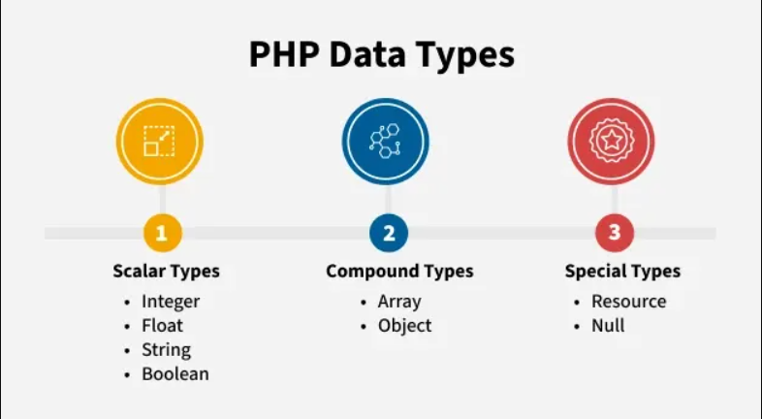
PHP Data Types
In PHP, data types define the kind of value a variable can hold. PHP supports 8 main data types, grouped into three categories:
Scaler Data Types
Compound Data Types
Special Data Types

Slide 15
Operators in php
Operatores are a symbol that tell computer to perform some operation on values and variables
Arithmetic operator
Assignment operator
Logical operator
Ternary operator
Comparision operator

Slide 16
functions in php
A fuction is a block of code that perform a specific task.
you can write the code once and use it many times by calling the function
Syntax
Function function_name{
//statements
}

Slide 17
Create a function
function myMessage() {
echo "Hello world!";
}
myMessage();

Slide 18
Create a function
function introduceMe() { echo "Hi”;
echo "I am Tuba";
echo "I am a web developer <br><br>";
}
introduceMe();

Slide 19
function with return value
<?php
function sum($eng,$urdu,$math){
$sum = $eng + $urdu + $math;
return $sum;
}
echo $total = sum(34, 78, 90);
?>

Slide 20
function with parameter
<?php
function greet($name) {
echo "Hello, " . $name . "!<br>";
}
greet("Zara"); // Output: Hello, Zara!
?>

Slide 21
arrays in php
An array is a special variable , in whichyou can hold more than one valueat a time.
Array function is used to create an aarayin php.
Types of arrays in php.
Indexed array- Arrays with a numeric index
Associative arrays – Arrays with named keys
Multidimentional arrays – Arrays containing one or more arrays

Slide 22
Types of arrays in php
INDEXED ARRAY
$subject = array(
“English”,
“Math”,
“Economics”
);
Hihkjhkj hjkhjkhjk hjkhjkhjk hjkhjk hjkhjk ASSOCIATIVE ARRAY
$age = array(
“Ali” => 23,
“Bilal” => 32,
“zara” =>33
);
key
value

Slide 23
indexed array
Ex – 1 (Indexed array)
$name = array(“Ali” , “Rehman” , “Usman” , “Bilal”);
Echo count($name);
Ex – 2
$name = array("Ali" , "Rehman" , "Usman" , "Bilal");
$arrlength = count($name); //4
for($x = 0; $x < $arrlength; $x++){
echo "Indexed number [$x] " .$name[$x];
echo "<br>";
}

Slide 24
indexed array
Ex - 3
$a =array (1,2,3,4,5,6,7,8,9);
$a[9]=“Ali";
echo "<pre>";
print_r($a)."<br>";
The print_r() function prints the information about a variable in a more human-readable way.

Slide 25
Associative array
Ex - 4
$name = array(1=>“Usman", 2=>"komal", 3=>"nosheen", 4=>"ayesha", 5=>"neha", 6=>"hafsa" );
$a[5]="urooj";
$a[9]="alia";
$a[10]="ali";
$a[11]="azam";
$a[12]="hamza";
echo "<pre>";
print_r($a);
echo "</pre>";

Slide 26
Associative array
Ex -5 (associative array)
$marks=[“Phy"=>90,“Math"=>90,“Economics"=>70];
Echo $marks[“phy”]; //90
echo “Ali has got “ .$marks[‘phy’] .”marks.”;

Slide 27
for each loop syntax in php
forech($array as $value){
//statement
}

Slide 28
for each loop for indexed array in php
$test = array(10,20,30,40);
forech($test as $value){
echo $value .”<br>”;
}

Slide 29
for each loop for associative array in php
$age = [
“Ali” => 23,
“Bilal” => 32,
“zara” =>33
];
forech($age as $key => $value){
echo $key .”=“ .$value .”<br>”;
}

Slide 30
Multi-dimentional array
Ex - 6
$a = array(
array(1,2,3,4,5),
array(6,7,8,9,10),
array(11,12,13,14),
array(15,16,17,18,19,20)
);
echo $a[0][1]."<br>";
echo $a[3][3]."<br>";
echo $a[2][2];
echo"<pre>";
print_r($a);
echo"</pre>";
echo "<br>";

Slide 31
Multi-dimentional array
Ex - 7
$data=[
[1,"Tuba","Engineer",40000],
[2,"Ali","Manager",50000],
[3,"Maha","Doctor",70000]
];
echo "<pre>";
print_r($data);
echo "<br>";

Slide 32
Multi-dimentional array
Ex - 7
$a = array(
array(1,2,3,4,5),
array(6,7,8,9,10),
array(11,12,13,14),
array(15,16,17,18,19,20)
);
echo $a[0][1]."<br>";
echo $a[3][3]."<br>";
echo $a[2][2];

Slide 33
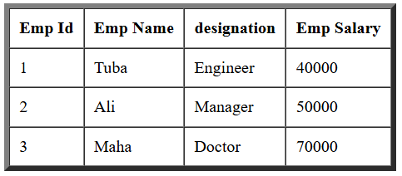
Multi-dimentional array
Ex - 8
$data=[
[1,"Tuba","Engineer",40000],
[2,"Ali","Manager",50000],
[3,"Maha","Doctor",70000]
];
echo "<table border='5px' cellpadding='9px' cellspacing='0'>";
echo "<tr>
<th>Emp Id</th>
<th>Emp Name</th>
<th>designation</th>
<th>Emp Salary</th>
</tr>";
foreach($data as $value){
echo "<tr>";
foreach($value as $alldata){
echo "<td> $alldata </td>";
}
echo "</tr>";
}
echo "</table>";
00
01
02
03
10
11
12
13
20
21
22
23

Slide 34
PHP Form Handling
Form handling is the process of collecting and processing information that users submit through HTML forms. In PHP, we use special tools called $_POST and $_GET to gather the data from the form. Which tool to use depends on how the form sends the data—either through the POST method (more secure, hidden in the background) or the GET method (data is visible in the URL

Slide 35
How html interact with php
Execute php code
Web Browser
HTTP Request
PHP
HTTP Response
Web Server

Slide 36
PHP Form Handling
Types of request
Get Request
Post Request

Slide 37
PHP Form Handling
Get Request
Request is visible in the address bar
Less secure request
Mostly used to get data from the server
Post Request
Request is not visible in the address bar
Secure
Used for create and update operations on server

Slide 38
Send data with GET Request
Make HTML file
Make PHP file
Make input field in HTML file
Receive data in PHP file

Slide 39
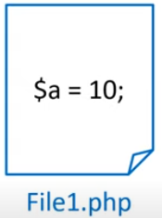

PHP : super global variable
Super global variable

Slide 40
PHP : super global variable
$_GET
$_POST
$_REQUEST
$GLOBALS
$_SERVER
$_SESSION
$_COOKIE
$_FILES

Slide 41
php : $_get & $_post
$_POST : It is a super global variable used to collect data from the HTML form after submitting it.

Slide 42
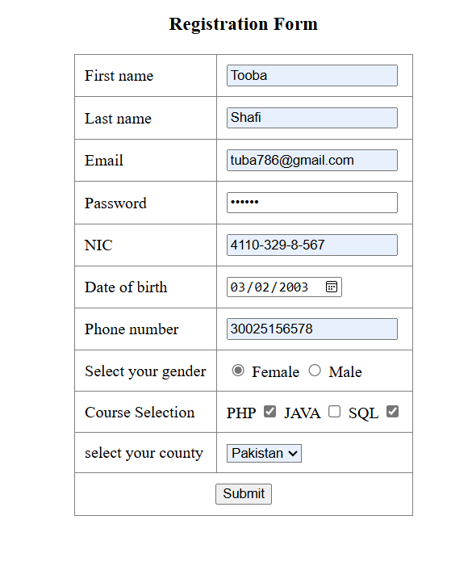
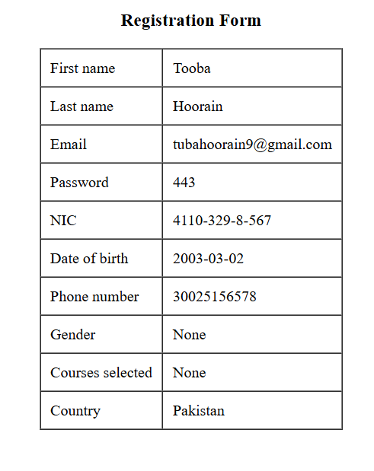
php : $_get & $_post
File1.php
File2.php
Database
print

Slide 43
form using get and post method
name: The name attribute is crucial in PHP form handling, as it is used to refer to the data submitted by the form fields.
$username = $_POST['username']; // Accessing the form data

Slide 44
form using get and post method
Ex-1:
Login.html
<form method="get" action="login.php">
<input type="text" name="user_name" placeholder="Enter user name">
<br><br>
<input type="password" name="user_password" placeholder="Enter user password">
<br><br>
<button type="submit">Login</button>
</form>

Slide 45
form using get and post method
Login.php
<?php
echo "This is php login file"
?>

Slide 46
Php : $_server
HTTP connection
Server Information
Host Information
URL Information
2nd page not use

Slide 47
Php : $_cookie
A cookie is a small text file that is stored in the user's browser. Cookies are used to store information that can be retrieved later.
Cookies in PHP are created using the setcookie() function. When a cookie is set, the data is stored in the user’s browser and sent to the server with each subsequent request made by the browser.
ookies in PHP are created using the setcookie() function.

Slide 48
Php : $_cookie
Syntax:
setcookie(name, value, expire, path, domain, security,httponly);
Name: It is used to set the name of the cookie.
Value: It is used to set the value of the cookie.
Expire: It is used to set the expiry timestamp of the cookie, after which the cookie can't be accessed.
Path: It is used to specify the path on the server for which the cookie will be available.
Domain: It is used to specify the domain for which the cookie is available.
Security: It is used to indicate that the cookie should be sent only if a secure HTTPS connection exists.

Slide 49
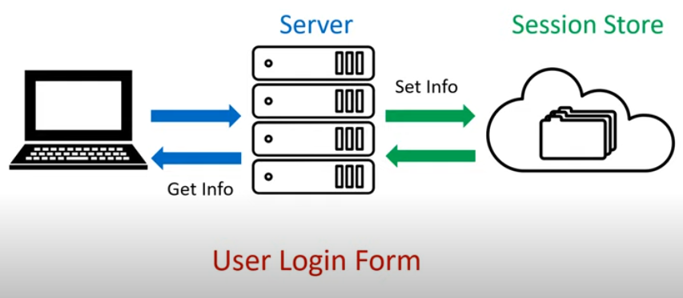
Php : $_session

Slide 50
Php : $_server
A PHP session stores user data on the server and uses a unique session ID to keep track of the user across multiple pages.

Slide 51
Three step to get and set session value
Using PHP sessions involves several key steps: starting a session, storing data in session variables, retrieving data, and eventually destroying the session when no longer needed.
Step 1: Starting a Session (session_start(); // Start the session)
Step 2: $_SESSION[‘name'] = ‘value'; //set session name and value
Step 3 : echo $_SESSION[‘name'];
Delete session:
Step 1: session_unset(); //remove all session variable
Step : session_destroy();

Slide 52
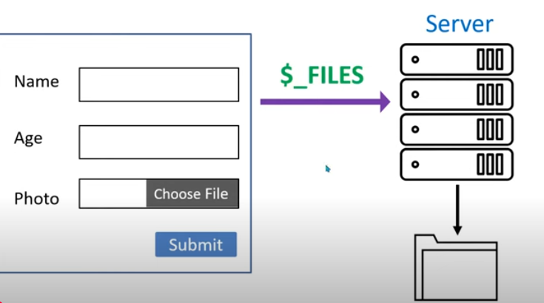
Php : $_file
Folder on server

Slide 53
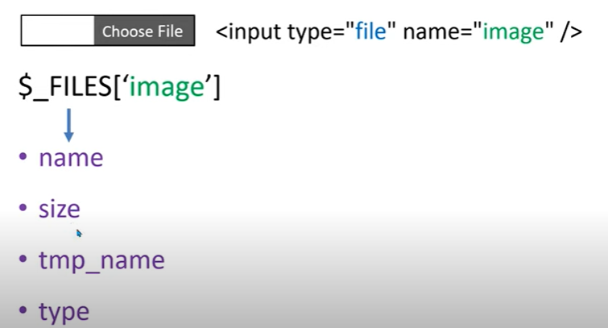
Php : $_file
(JPG/PNG/GIF)
Move_uploaded_file(file,dest)
//upload img on server
Once we get information then we will use this function

Slide 54
Move_uploaded_file :
Used to upload client side image on server

Slide 55
Php die and exit function
Move_uploaded_file :
Used to upload client side image on server

Slide 56
Connecting PHP with MySQL Database
Make variables for connection
Make connect with mysqli class
Get the table list from database

Slide 57
Connecting PHP with MySQL Database
Ex:
<?php
$host = "localhost";
$user = "root";
$pass = " ";
$db = "demo";
$con = mysqli_connect($host,$user,$pass,$db);
if($con){
echo "OK";
}
else
{
echo "DB not Connect";
}
?>

Slide 58
Connecting PHP with MySQL Database (connect.php)
<?php
$hostname = 'localhost';
$username = 'root';
$password = '';
$database = 'signupform';
$con = mysqli_connect($hostname, $username, $password, $database);
if (!$con) {
die("Connection failed: " . mysqli_connect_error());
}
?>

Slide 59
Connecting PHP with MySQL Database (signup.php/html form)
<?php if ($_SERVER['REQUEST_METHOD'] == 'POST') {
include 'connect.php'; $username = $_POST['username'];
$password = $_POST['password']; $sql = "INSERT INTO registration (username, password) VALUES ('$username', '$password')";
$result = mysqli_query($con, $sql); }
?>

Slide 60
Form validation in javascript
Form validation in PHP is the process of checking
user input in an HTML form before the data is sent to the server.
This helps ensure that the submitted data is complete
and in the correct format.

Slide 61
What isphp crud:
database
create
read
update
delete

Slide 62
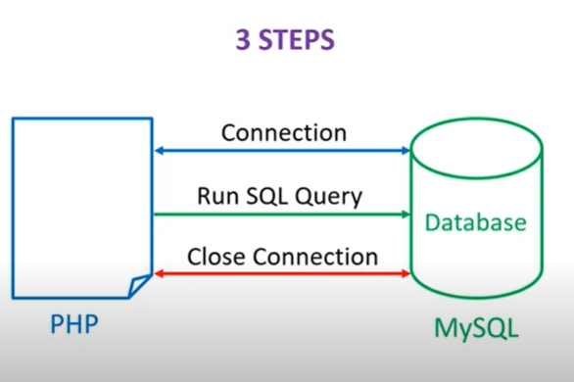
Php and mysql programming steps

Slide 63
Connection
mysqli_connect(server name, user name, password, database name);
Ex:
$con = mysqli_connect($hostname, $username, $password, $database);
Run SQL Query
mysqli_query(connection name , sql query)
Close connection
Mysqli_close(connection name)

